Slide 1
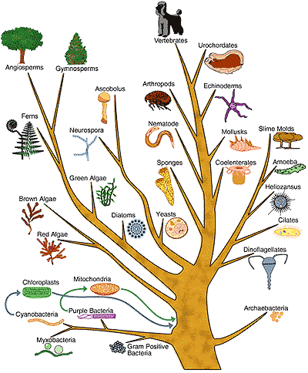
Introduction into Phylogenetics
Katja Nowick
Group Leader
“TFome and Transcriptome Evolution”
Bioinformatics Group
Paul-Flechsig-Institute for Brain Research
University Leipzig

Slide 2
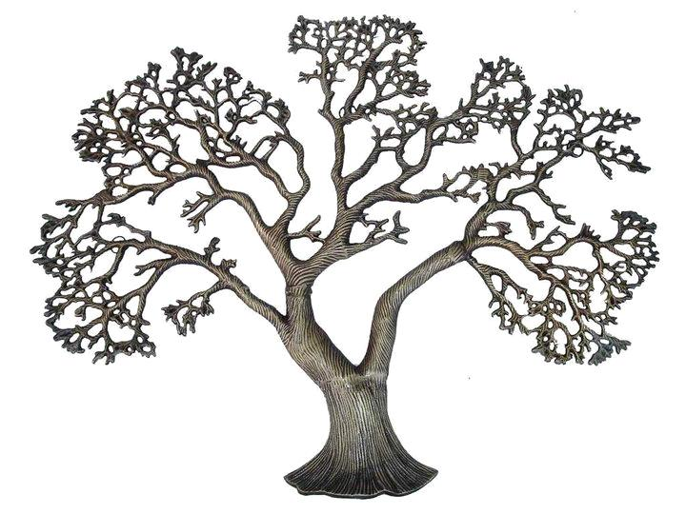
What is a tree?
Tree = a biological organism
= a mathematical structure
Trees reflect how similar/related things are
Leaves = Things
Branches show relationship of the things
Examples:
Species tree – how similar are species
Gene trees – how similar are genes
…

Slide 3
A species tree

Slide 4
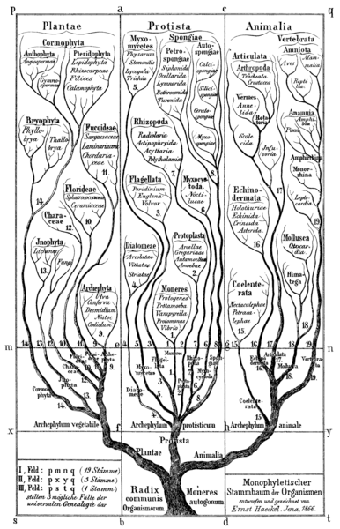
Haeckel’s tree of life: another species tree

Slide 5
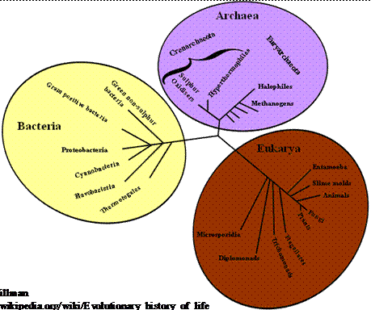
Tree of life: Another species tree

Slide 6
Another visualization of a species tree

Slide 7
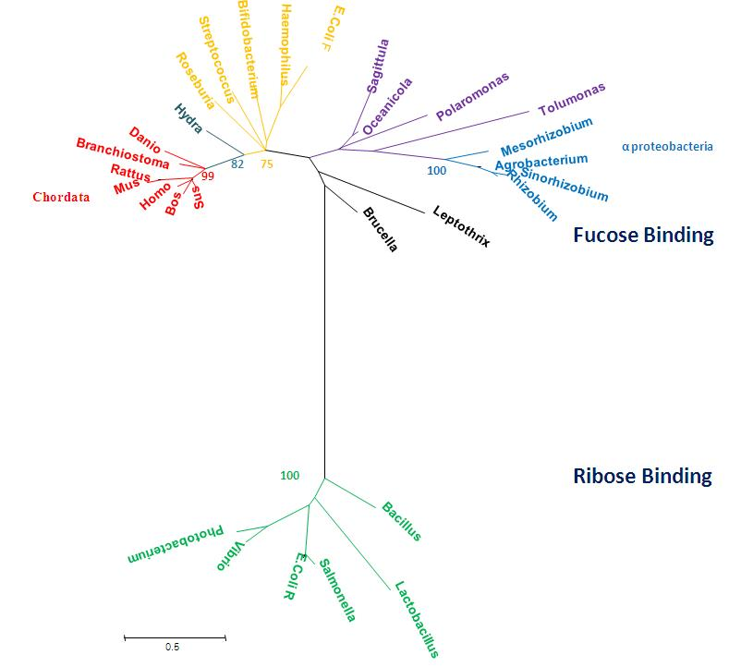
Another visualization of a species tree

Slide 8
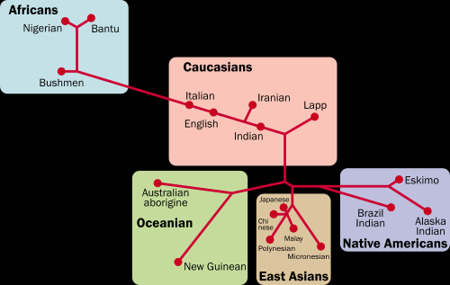
Tree of human populations

Slide 9
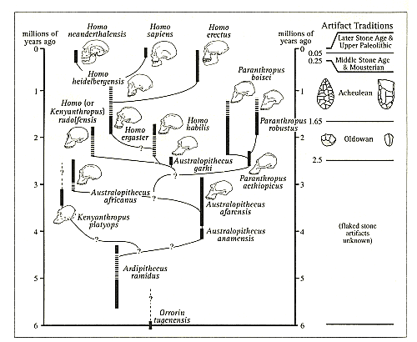
Tree of human species

Slide 10
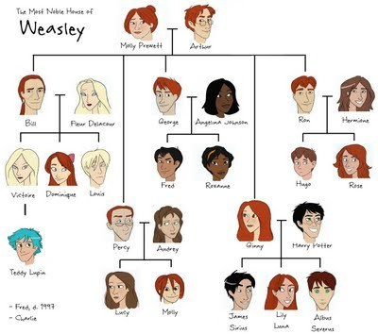
A family tree

Slide 11
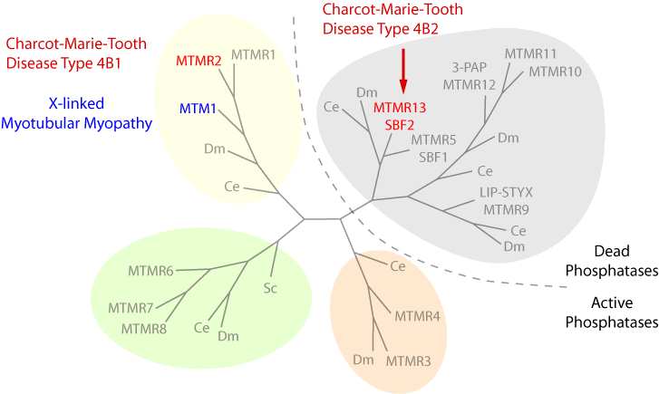
A gene tree

Slide 12
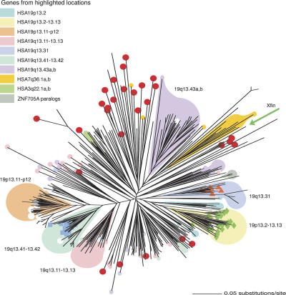
Another gene tree

Slide 13
A tree of gene expression patterns in multiple tissues

Slide 14
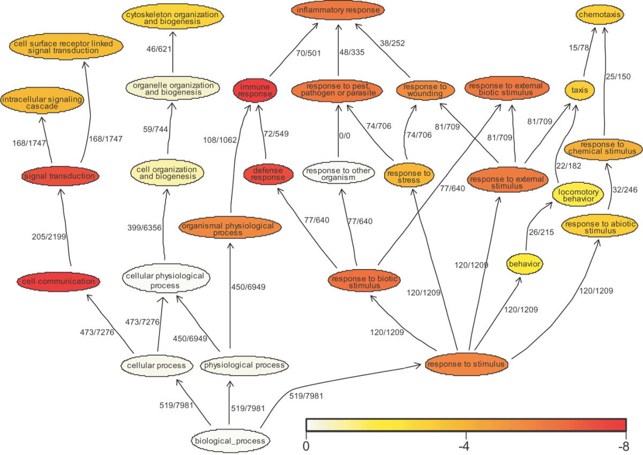
A tree of Gene Ontology groups

Slide 15
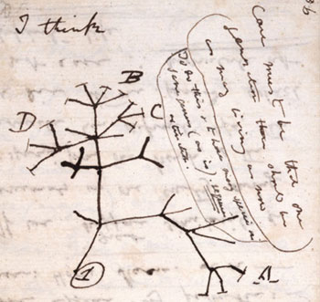
The first drawn tree (Darwin)

Slide 16
Topic today: Evolutionary trees / phylogenetic trees
All in life is related by common ancestry
Phylogenetics refers to the evolutionary relatedness of organisms (species, populations …)
But all the following methods can be used for any type of data as long as characters have more than one state

Slide 17
Terminology
Tree = a mathematical structure
Trees reflect how similar/related things are
Things = nodes in the tree, e.g. species
Terminal nodes (leaves) = species (for which we have data)
Internal nodes = inferred ancestors
Branches (edges) show relationship
Length of the branch can reflect evolutionary time (weighted trees)
Terminology differs between disciplines
Usually data for ancestors are sparse (only fossils),
so the evolutionary history has to be reconstructed based on living species

Slide 18
Branches can be freely rotated
1 2 3 4 5 6
1 3 2 4 5 6
1 5 4 3 2 6

Slide 19
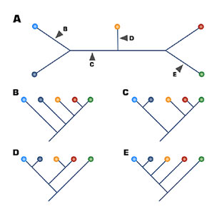
Unrooted vs rooted trees
Unrooted
Rooted
Choosing different branches as roots
Only rooted trees have an evolutionary direction

Slide 20
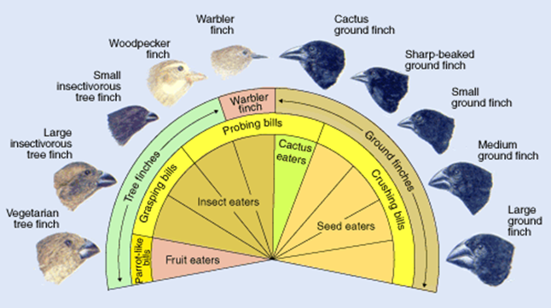
Resolved vs unresolved trees
Polytomy = when a node has more than 3 branches (more than 1 ancestor + two descendents)
Either the lineages really diverged at the same time (or very rapidly)
or we don’t know what the real divergence pattern is
Example of a star tree:
Radiation of Darwin finches

Slide 21
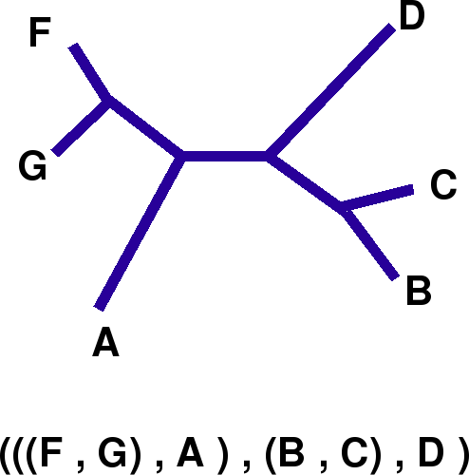
Newick format
Newick format used by many computer programs:

Slide 22
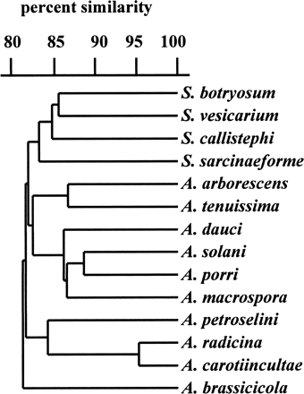
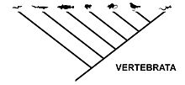
Different types of trees
Cladogram
Most simple tree
Just shows relative recency
Branch length has no meaning
Phylogram
Additive tree
Branch length reflects
number of changes
Dendrogram
Ultrametric tree
Special form of a phylogram
All tips equal length from root
Axis = divergence time
assuming molecular clock

Slide 23
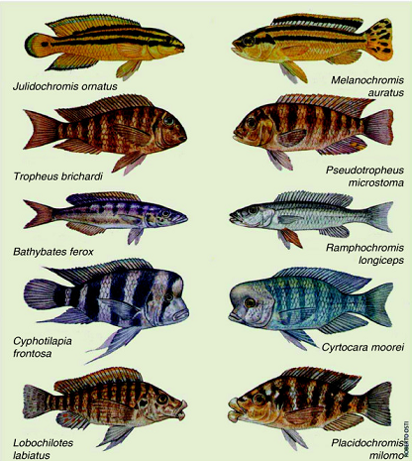
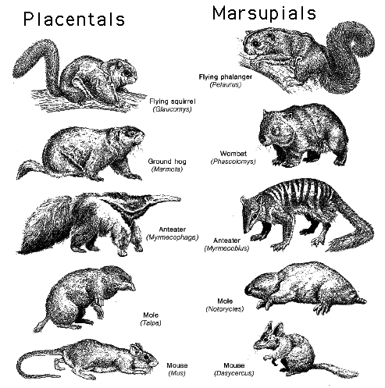
Homoplasy
Homoplasy: similarity acquired independently, i.e. not by descent
Parallel evolution
Same characters from the same ancestral condition
cichlids in Lake Malawi and Lake Tanganyika
Convergent evolution
Same characters from different ancestral condition

Slide 24
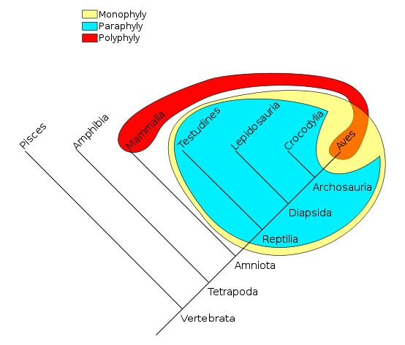
Phyla grouping
Monophyletic:
All birds and reptiles are believed to have descended from a single common ancestor (yellow).
Paraphyletic:
"Modern reptile" (cyan) is a grouping that contains a common ancestor, but does not contain all descendants of that ancestor (birds are excluded).
Polyphyletic:
A grouping such as warm-blooded animals would include only mammals and birds (red/orange); members of this grouping do not include the most recent common ancestor

Slide 25
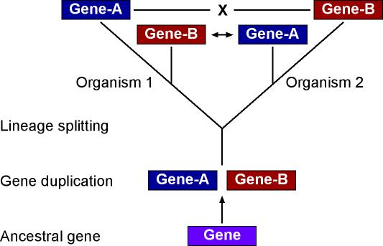
Gene tree and species tree do not always agree
Homology:
Orthologous genes
created by speciation event
Paralogous genes
created by gene duplication
Speciation
→ To learn about species relationship use only orthologous genes

Slide 26
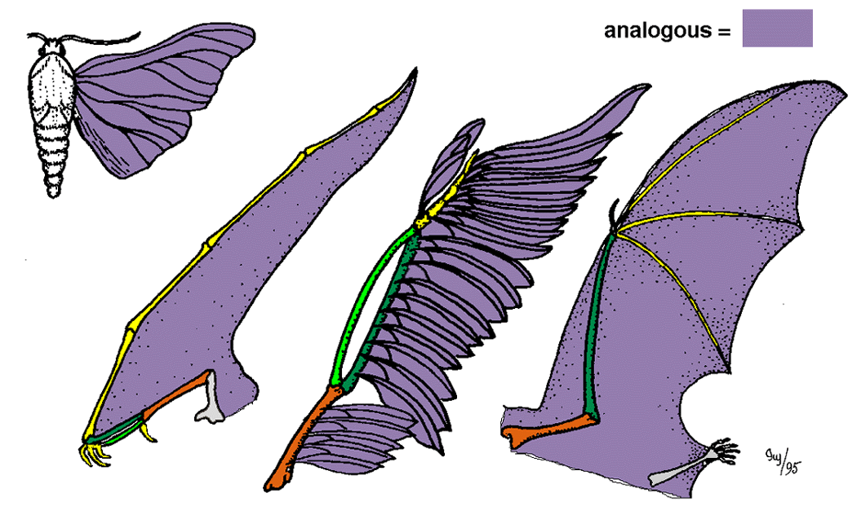
Characters for trees
Traditionally, morphological characters have been used to infer phylogenies
For any phylogenetic analysis, always need to look at many characters:
For example, birds and bats have wings, while crocodiles and humans do not. If these were the only data available, we would tend to group crocodiles with humans, and birds with bats
Molecular phylogenetics uses DNA, protein sequence characters

Slide 27
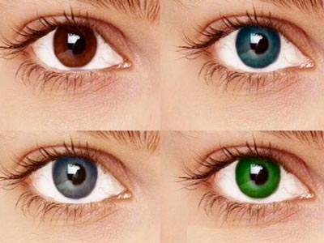
Characters for trees
You can take any kind of character, as long as it has more than one state, e.g. eye color: blue, brown
What about gray and green eyes? Make an extra attribute/character state or put them together with blue or brown depending on what is more similar
Character states for DNA: AGTC
for protein: A,C,G,K,L,H,...
How to treat missing data, e.g. an animal has no eyes, or the color is unknown for whatever
reason?
Usually put a "?" or "-" or "X", or "N",
the latter things are common for sequence data

Slide 28
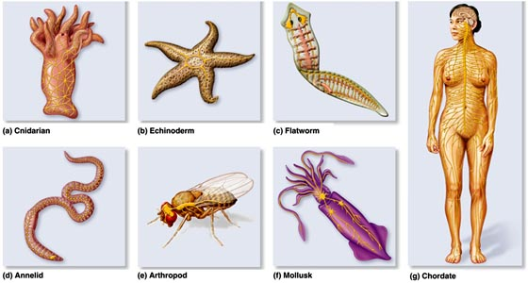
Characters states can be ordered
If going from one state to another requires more than one step:
e.g. cannot go directly from simple brain in cnidaria to complex brain in humans
with a lot of different brain regions, gyri, sulci ; or dorsal vs ventral nervous system

Slide 29
Characters states changes can be weighted
Give more weight to changes that are less common:
e.g. transversions (A-C, A-T, G-C, G-T changes) are less common than transitions
changes in 3rd codon position are more common than in 1st or 2nd (might be neutral)

Slide 30
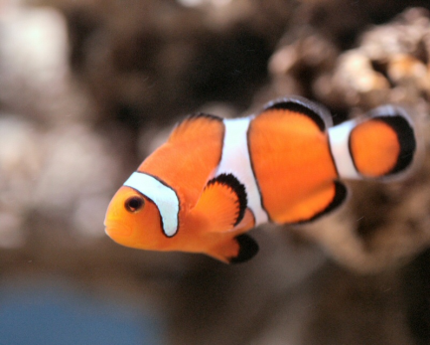
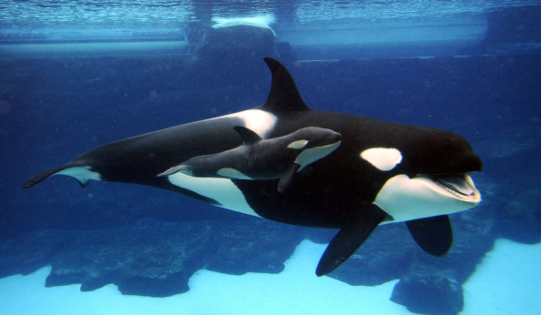
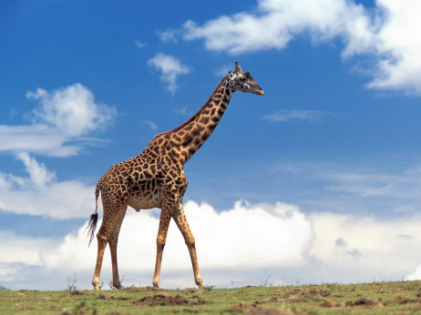
Look at more than one character
Idea: if two species share a trait that is not in a third, the two are more related to each
Group dolphin and giraffe because they have a placenta
Or group fish and dolphin because they live in water (parallel evolution)
So depending on the character, we might end up with a different tree
→ Need to find the optimal tree taking into account all parameters

Slide 31
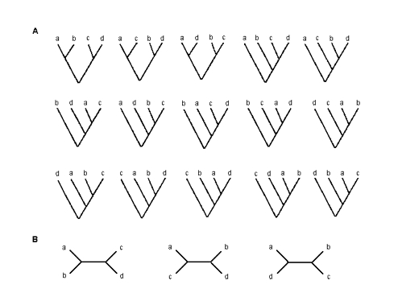
Number of possible trees can be enormous
All possible trees of 4 species
(rooted / unrooted)
Each taxon represents a new sample for every character, but, more importantly, it (usually)
represents a new combination of character states
Ten species gives over two million possible unrooted trees
→ How to find the right tree?
It’s a NP-complete problem (NP= non-deterministic polynomial)
i.e. for any reasonable number of characters it is often impossible to find the optimal tree
We need some heuristics (“quick and dirty”)
Different methods might produce different tress

Slide 32
Tree building methods
Sequences
Distances
sites
1 2 3 4 5 6 7
1 T T A T T A A
2 A A T T T A A
3 A A A A A T A
4 A A A A A A T
sequence
2 3
3 5 4
4 5 4 2
1 2 3
sequence
sequences
1
1
3
2
3
1
4
5
6
1
2
2
2
3
7
4
2
1
1
4
Discrete method
e.g. Parsimony tree
Distance method
e.g. Neighbor-joining tree
The 7 substitutions are placed on the 5 branches
The 7 substitutions are apportioned over the 5 branches
Sum of the branch length is the same in both trees: 7
But in the parsimony tree we see which site contributes to the length of each branch

Slide 33
Tree building methods
Clustering methods
Optimality criteria
Start with three species
Add the others in a step-wise fashion
Easy to implement
Fast, good for large datasets
Produce only one tree
Not possible to evaluate the resulting trees compared to alternatives
Information about which sites contribute to branch length missing
e.g. Neighbor-joining tree
Make all possible trees
Evaluate (score) trees to find the tree that best explains the data = the tree with the fewest number of evolutionary steps
Computationally intense
Provides information about which sites contribute to branch length missing
e.g. Maximum Parsimony tree
Maximum Likelihood

Slide 34
Neighbor-joining method
Clustering method
Distance method
Start by making a distance matrix:
Sequences
Distances
sites
1 2 3 4 5 6 7
1 T T A T T A A
2 A A T T T A A
3 A A A A A T A
4 A A A A A A T
sequence
2 3
3 5 4
4 5 4 2
1 2 3
sequence
sequences
Algorithm:
1. Based on the current distance matrix calculate the matrix Q (defined below).
Find the pair of taxa in Q with the lowest value. Create a node on the tree that joins
these two taxa (i.e., join the closest neighbors, as the algorithm name implies).
3. Calculate the distance of each of the taxa in the pair to this new node.
4. Calculate the distance of all taxa outside of this pair to the new node.
Start the algorithm again, considering the pair of joined neighbors as a single taxon and
using the distances calculated in the previous step.

Slide 35
Neighbor-joining method
1. Based on the current distance matrix calculate the matrix Q (defined below).
Distance matrix
Q matrix
 | A | B | C | D
A | 0 | 7 | 11 | 14
B | 7 | 0 | 6 | 9
C | 11 | 6 | 0 | 7
D | 14 | 9 | 7 | 0
 | A | B | C | D
A | 0 | −40 | −34 | −34
B | −40 | 0 | −34 | −34
C | −34 | −34 | 0 | −40
D | −34 | −34 | −40 | 0
r= # taxa
i, j = taxa (A,B,C,D)
k = always the other taxa
AB
AB AC AD
AB BC BD
AB: Q(A,B) = (4-2) * 7 - (7+11+14) - (7+6+9)
= 14 - 32 - 22
= -40
AC
AB AC AD
AC BC DC
AC: Q(A,C) = (4-2) * 11 - (7+11+14) - (11+6+7)
= 22 - 32 - 24
= -34
…
Notes:
You cannot just take the pair with the two closest leaves. Because if one of the branches has a lot of changes and the other not, the one with the short branch might get grouped with wrong taxa. The trick to avoid this, is to subtract the average distance to all other leaves – this compensates for the effect of long branches
r-2 is the number of pairs of neighbors that can be found in any bifurcating tree

Slide 36
Neighbor-joining method
Find the pair of taxa in Q with the lowest value. Create a node on the tree that joins
these two taxa (i.e., join the closest neighbors, as the algorithm name implies).
Q matrix
 | A | B | C | D
A | 0 | −40 | −34 | −34
B | −40 | 0 | −34 | −34
C | −34 | −34 | 0 | −40
D | −34 | −34 | −40 | 0
Join taxa A and B to a new node: u

Slide 37
Neighbor-joining method
3. Calculate the distance of each of the taxa in the pair to this new node.
Distance matrix
Distance of A and B to the new node:
 | A | B | C | D
A | 0 | 7 | 11 | 14
B | 7 | 0 | 6 | 9
C | 11 | 6 | 0 | 7
D | 14 | 9 | 7 | 0
u = the new node
f,g = the joined taxa (A,B)
AB
AB AC AD
AB BC BD
A: d(A,u) = ½*7 + 1/2(4-2) * [(7+11+14) – (7+6+9)]
= 3.5 + ¼ * [ 32 – 22 ]
= 3.5 + 2.5
= 6
B: d(B,u) = 7 – 6 =1
Notes:
Divided by 2 because each path is walked twice
B: distance of A to B minus the part that got assigned for A to reach AB

Slide 38
Neighbor-joining method
4. Calculate the distance of all taxa outside of this pair to the new node.
Distance of C and D to the new node:
u = the new node
k = taxa to calculate distance for (C,D)
Distance matrix
C: d(u,C) = ½ * [11 + 6 – 7]
= ½ * 10
= 5
D: d(u,D) = ½ * [14 + 9 -7]
= ½ * 16
= 8
 | A | B | C | D
A | 0 | 7 | 11 | 14
B | 7 | 0 | 6 | 9
C | 11 | 6 | 0 | 7
D | 14 | 9 | 7 | 0
New Distance matrix
 | AB | C | D
AB | 0 | 5 | 8
C | 5 | 0 | 7
D | 8 | 7 | 0
Notes:
= distance of C to A + distance of C to B minus the distance that got already assigned for A to B, then divide by 2

Slide 39
Neighbor-joining method
Start the algorithm again, considering the pair of joined neighbors as a single taxon and
using the distances calculated in the previous step.
New Distance matrix
New Q matrix
 | AB | C | D
AB | 0 | 5 | 8
C | 5 | 0 | 7
D | 8 | 7 | 0
 | AB | C | D
AB | 0 | -20 | -20
C | -20 | 0 | -20
D | -20 | -20 | 0
r= # taxa: now 3
i,j = taxa (AB,C,D)
AB-C
AB-C AB-D
AB-C CD
AB-C: Q(AB,C) = (3-2) * 5 – (5 + 8) – (5+7)
= 5 - 13 - 12
= -20
AB-D: Q(AB,D) = (3-2)*8 – (5 + 8) – (8 + 7)
= 8 - 13 - 15
= -20
CD: …
AB-D
AB-C AB-D
AB-D CD

Slide 40
Neighbor-joining method
Join C to AB
A
New Distance matrix
 | ABC | D
ABC | 0 | 5
D | 5 | 0
6
C
3
2
AB
ABC
B
1
Distance A to AB was 6
Distance B to AB was 1
Distance AB to ABC is 3
Distance C to ABC is 2
Distance D to ABC is 5
5
D
Algorithm produces tree with the shortest total branch length
unrooted, but outgroup can be added
root = where the edge of the outgroup meets the tree
no molecular clock assumed
uses a greedy algorithm: solve one problem at the time, then the next problems (step-wise adding of the next nodes)
it's computationally efficient but might not find the optimal tree (but often it finds the optimal tree or something close)

Slide 41
Tree building methods
Clustering methods
Optimality criteria
Start with three species
Add the others in a step-wise fashion
Easy to implement
Fast, good for large datasets
Produce only one tree
Not possible to evaluate the resulting trees compared to alternatives
Information about which sites contribute to branch length missing
e.g. Neighbor-joining tree
Make all possible trees
Evaluate (score) trees to find the tree that best explains the data = the tree with the fewest number of evolutionary steps
Computationally intense
Provides information about which sites contribute to branch length missing
e.g. Maximum Parsimony tree
Maximum Likelihood

Slide 42
Maximum parsimony
Method:
1. Make all possible trees
2. Score them by the total number of character state changes required (= "evolutionary steps") to explain distribution of each character
3. Pick the tree that infers the least steps/number of changes = the most parsimonious
1
Tree 2
2
1 ATATT
2 ATCGT
3 GCAGT
4 GCCGT
1
Tree 1
3
3
4
1
Tree 3
2
2
4
4
3
For the first site:
(two examples of what the ancestral version (internal node) could have looked like)
A
G
A
G
A
G
G
A
A
G
A
G
Only one change required
= more parsimonious
Five change required

Slide 43
Maximum parsimony
1 ATATT
2 ATCGT
3 GCAGT
4 GCCGT
1
Tree
3
2
4
For the first site:
A
1 step
G
A
G
A
G
For the other sites:
T
1 step
C
A
2 steps
A
T
1 step
G
T
0 steps
T
T
C
A
A
G
G
T
T
T
C
C
C
G
G
T
T
or
Not informative for phylogeny because all sites are the same
A
2 steps
A
C
C
C
C
Σ
k
L =
l
Total length of the tree L = total # evolutionary changes/steps
= sum of length l of each site k; here: 1 + 1 + 2 + 1 + 0 = 5
i
i=1

Slide 44
Maximum parsimony
1 ATATT
2 ATCGT
3 GCAGT
4 GCCGT
Alternative trees:
1
Tree 1
3
1
Tree 2
2
1
Tree 3
2
2
4
3
4
4
3
1 + 1 + 2 + 1 + 0 = 5
2 + 2 + 1 + 1 + 0 = 6
2 + 2 + 2 + 1 + 0 = 7
Tree with shortest total branch length
= most parsimonious tree

Slide 45
Maximum parsimony
Are all changes equally likely?
e.g. transversions are rarer than transitions, i.e. less likely
→ Assign higher costs to transversions; e.g. 1 transversion counts as 2 steps
1
1
 | A | C | G | T
A | 0 | 2 | 1 | 2
C | 2 | 0 | 2 | 1
G | 1 | 2 | 0 | 2
T | 2 | 1 | 2 | 0
A
G
A
G
1
1
1
1
2
2
2
2
C
T
C
T
1
1
1 ATATT
2 ATCGT
3 GCAGT
4 GCCGT
Site 3 in tree 1 and 3
Site 3 in tree 2
A
A
A
C
C
C
A
C
C
C
A
C
1
Tree 1
3
1
Tree 2
2
1
Tree 3
2
2
4
3
4
4
3
1 + 1 + 4 + 1 + 0 = 7
2 + 2 + 2 + 1 + 0 = 7
2 + 2 + 4 + 1 + 0 = 9
→ Now tree 1 and 2 are equally parsimonious

Slide 46
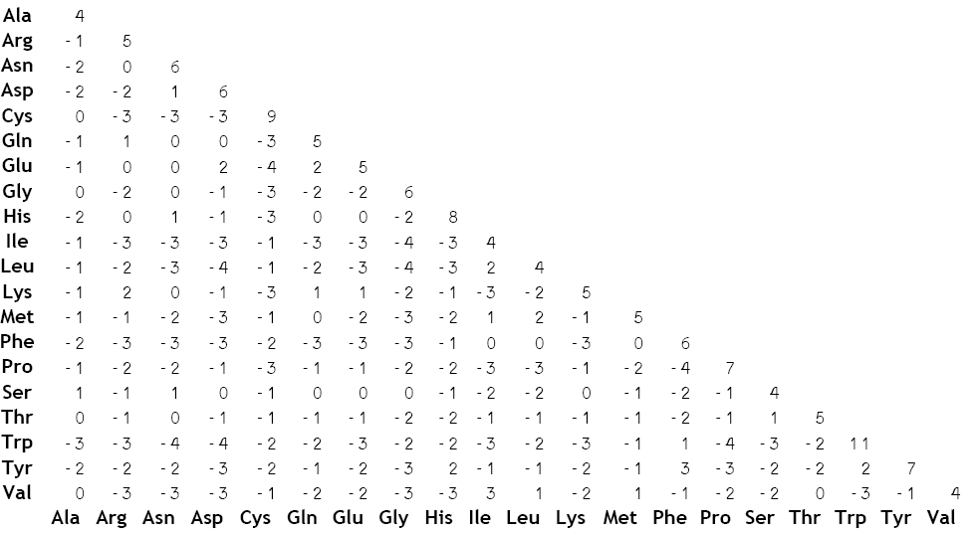
Maximum parsimony
Are all changes equally likely?
Substitution matrices for protein alignments: PAM, BLOSUM

Slide 47
Maximum parsimony
Are all changes equally likely?
Some sites might be highly conserved (e.g. functional domains of a protein) while others might be rapidly changing (e.g. intronic sites)
Rapidly changing sites might be saturated and therefore misleading for the tree
Give sites different weights
This will affect the total length of the tree:
Σ
Σ
k
k
L =
l
L =
w * l
i
i
i
i=1
i=1

Slide 48
Maximum parsimony
After scoring all trees find the most-parsimonious trees (MPTs)
often exist a number of equally MPTs
if too many, maybe because of too many missing data; insufficient data to resolve the tree completely
often only parts of the tree (sub trees) differ between the MPTs, e.g. a few taxa jump around
can make a consensus tree

Slide 49
Maximum parsimony
Finding the optimal tree (the tree with the best score) is computationally expensive
→ a possibility is to start with one good tree, perturb it and see if the score gets better
Trees are unrooted, but you can chose an outgroup
Trees do not reflect divergence times

Slide 50
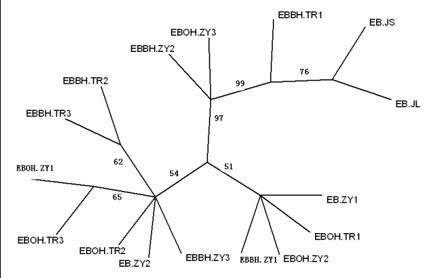
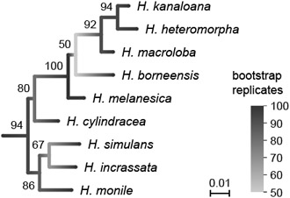
How well supported is the tree?
Bootstrap method:
Randomly pick characters from your dataset (e.g. columns in the alignment)
Make a random dataset that has the same size as your real dataset
Characters are picked with replacement
Do this multiple times, typically 1000 times
How often do you find a certain branch among the random trees?
More suitable for Neighbor-joining than Maximum Parsimony, because computationally intense

Slide 51
Commonly used phylogenetic programs
Phylip (PHYLogeny Inference Package)
PAUP (Phylogenetic Analysis Using Parsimony)
Clustal

Slide 52
