Slide 1
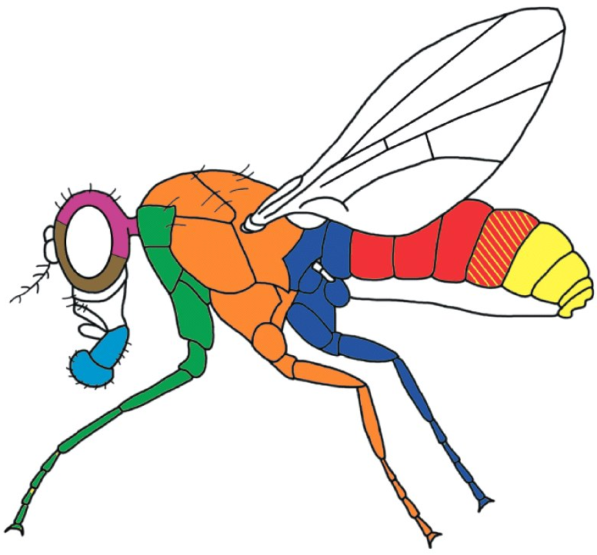
Pattern formation in drosophila
Katja Nowick
TFome and Transcriptome Evolution
nowick@bioinf.uni-leipzig.de

Slide 2
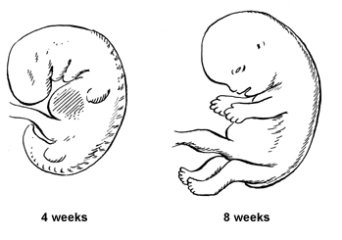
Single cell → multicellular organism

Slide 3
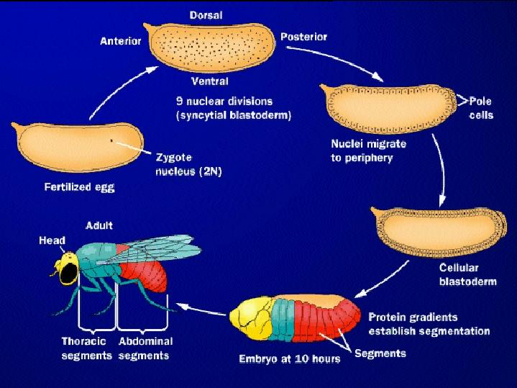
Drosophila development
embryogenesis
3h
Fertilized egg
5h
Adult fly
12d
24h
Larva = embryo
metamorphosis

Slide 4
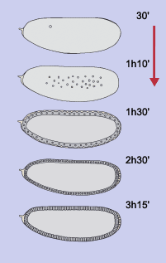
Early steps of embryogenesis
anterior
→ Fertilized egg
Nuclei divide but no cell division
Syncytium
Nuclei migrate to periphery,
Further nuclei divisions
→Synctial blastoderm
Membranes form between nuclei
→ Cellular blastoderm

Slide 5
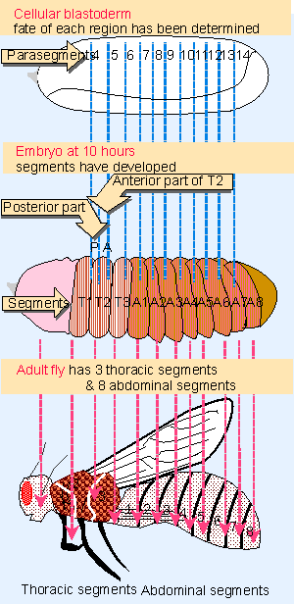
Later steps of development
5-6 hours
Grooves form at surface of embryo
→ parasegments
9-10 hours
Grooves get deeper and move
Centers of parasegments are now boundaries
between segments
T-segments form the thorax (3 T segments)
A-segments form the abdomen (8 A segments)

Slide 6
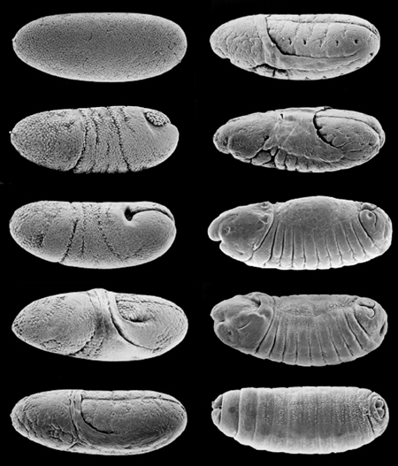
Drosophila embryogenesis
http://www.youtube.com/watch?v=ymRYxFYLsZ4&feature=relmfu
http://www.youtube.com/watch?v=Lb6TJzTLg_E&feature=related

Slide 7
Later steps of development
5-6 hours
Grooves form at surface of embryo
→ parasegments
9-10 hours
Grooves get deeper and move
Centers of parasegments are now boundaries
between segments
T-segments form the thorax (3 T segments)
A-segments form the abdomen (8 A segments)

Slide 8
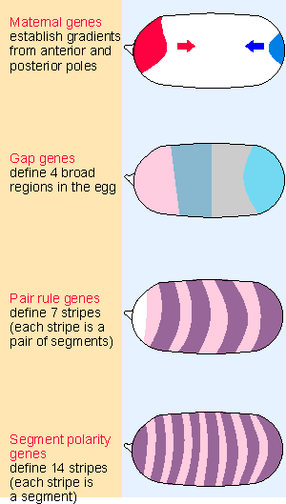
Early steps of embryogenesis
- Molecular processes -
Effect of mutations
Several adjacent segments missing
→ e.g. no head, no tail
Even-numbered or odd-numbered segments missing
Only half the number of segments
Either anterior or posterior part of a segment missing
Cascade of three types of genes:
Gap genes → Pair-rule genes → Segment polarity genes

Slide 9
Many developmental genes code for
transcription factors (TFs)
Cascade of three types of genes:
Gap genes → Pair-rule genes → Segment polarity genes
TF
Promoter
Gene
TFs: code for proteins that regulate the expression of other genes
activate or repress other genes

Slide 10
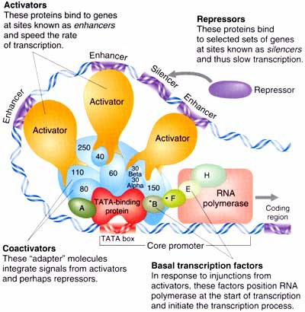
TFs regulate expression of other genes
Promoter
Gene
TFs: code for proteins that regulate the expression of other genes
activate or repress other genes
many TFs interact to start/stop transcription of a target

Slide 11
Transcription factors (TFs)
~ 1500 TFs in human genome
Tubby
Structural
AF-4
Dwarfin
BZip
Pocket domain
AP-2
ZNF
762
ZNF
Paired Box
HOX
199
GCM
HOX
TEA
BHLH
117
T-Box
BHLH
E2F
Trp cluster
Β-Scaffold
Other
NHR
Jumonji
FOX
Bromodomain
Heat shock
Methyl-CpG-binding
RFX
Modified after Messina et al., 2004

Slide 12
Gap genes
Gap genes → Pair-rule genes → Segment polarity genes
hunchback kruppel knirps giant
hunchback
˧
kruppel
knirps
giant
˧
˧

Slide 13
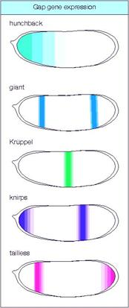
Regulation of gap genes
Network:
hunchback
˧
kruppel
knirps
giant
˧
Ⱶ
tailless
huckebein
˧
Ⱶ

Slide 14
Pair-rule genes
Gap genes → Pair-rule genes → Segment polarity genes

Slide 15
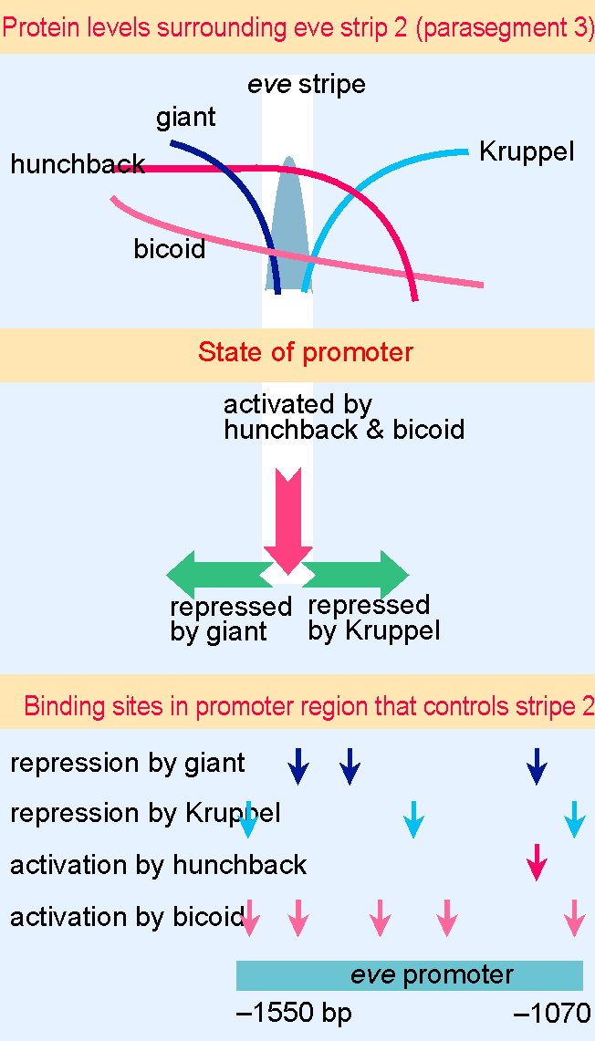
Regulation of pair-rule gene eve
eve = even-skipped
eve expression is controlled separately in each stripe using different binding sites in eve promoter

Slide 16
Regulation of pair-rule gene ftz
ftz = fushi-tarazu
ftz mRNA is region-specifically degraded

Slide 17
Regulation of segment polarity genes
Gap genes → Pair-rule genes → Segment polarity genes
→ Fertilized egg
Nuclei divide but no cell division
Syncytium
Nuclei migrate to periphery,
Further nuclei divisions
→Synctial blastoderm
Membranes form between nuclei
→ Cellular blastoderm
Are expressed in 14 stripes

Slide 18
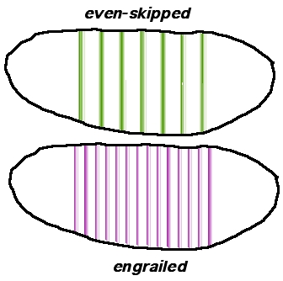
Regulation of segment polarity gene engrailed
Gap genes → Pair-rule genes → Segment polarity genes
7 stripes
14 stripes
engrailed expressed in every segment in the posterior (but not anterior) compartment

Slide 19
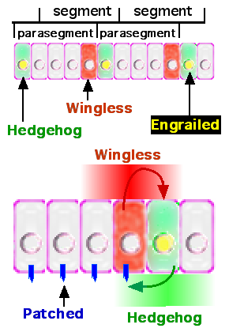
Refinement of the seven stripes
engrailed is expressed in every segment in the posterior compartment
engrailed induces hedgehog
hedgehog binds to patched receptor in neighbor cells
activation of wingless in neighbor cells
wingless stabilizes engrailed expression
wingless also activates naked cuticle and the receptor frizzled in adjacent rows, which inhibits engrailed
By receptors and secreted proteins → cell-cell interactions

Slide 20
Later steps of development
5-6 hours
Grooves form at surface of embryo
→ parasegments
9-10 hours
Grooves get deeper and move
Centers of parasegments are now boundaries
between segments
T-segments form the thorax (3 T segments)
A-segments form the abdomen (8 A segments)

Slide 21
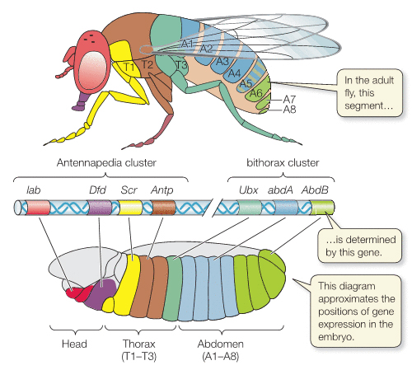
Homeotic genes
Segmentation genes → homeotic selector genes
Responsible for unique differentiation of each segment by modifying cell fates
Most are TFs, many contain a homeobox (HOX genes)
Order of genes on chromosome reflects about the spatial distribution of their expression

Slide 22
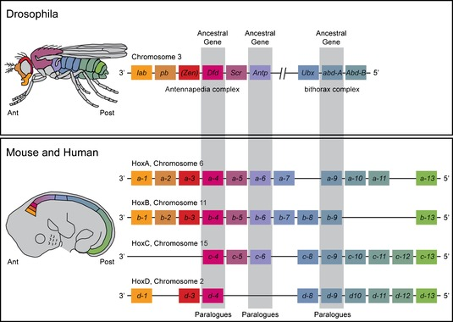
Homeotic genes in fly and mouse
Evolutionarily conserved processes

Slide 23
Intermediate summary
→ Fertilized egg
Nuclei divide but no cell division
Syncytium
Nuclei migrate to periphery,
Further nuclei divisions
→Synctial blastoderm
Membranes form between nuclei
→ Cellular blastoderm
But: How does the location of gap genes determined?

Slide 24
Maternal genes
aka Maternal effect genes
~30 different genes
Are expressed prior to fertilization
RNA is already present in the unfertilized egg in the ovary
Fertilization → RNA gets translated
Distribution of maternal RNA in the egg:
Uniformly for most genes, e.g. hunchback
Few exceptions: e.g. bicoid, nanos
Protein diffuses from point of RNA position and creates a gradient
Create the first asymmetry in the early embryo

Slide 25
Maternal genes
Maternal genes define 3 axes
Anterior system: development of the head and thorax
maternal RNA of bicoid is at the anterior end of the egg
bicoid functions as a TF, controls expression of hunchback (and probably also other segmentation and homeotic genes)
Posterior system: development of the abdominal segments
Controlled by localization of maternal RNA of nanos at the posterior end of the egg
nanos causes localized repression of hunchback (via control of translation of the mRNA)
Terminal system: development of the specialized structures at the unsegmented ends of the egg (the acron at the head, and the telson at the tail)
localized activation of the transmembrane receptor torso
Dorsal-ventral system: dorso-ventral development
transmembrane receptor Toll receives signals from a follicle cell on the ventral side of the egg
leads to a gradient of localization of the TF dorsal

Slide 26
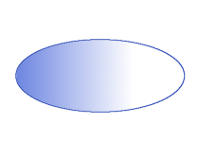
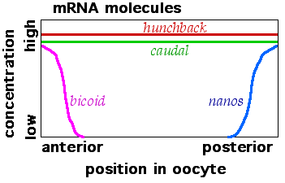
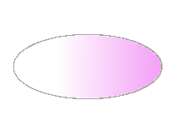
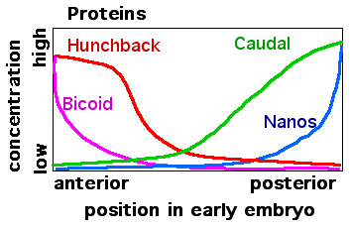
Anterior-Posterior axis
bicoid
nanos
bicoid → hunchback
nanos hunchback
˧

Slide 27
Anterior-Posterior axis
Effect of mutations in anterior-posterior axis determination:
Weaker gradient → anterior part of the embryo looks more posterior-like
Stronger gradient → anterior structures extend further posterior
Unfunctional bicoid: head and thoracic structures are converted to the abdomen making
the embryo with posterior structures on both ends, a lethal phenotype

Slide 28
Summary
Maternal → Gap → Pair-rule → Segment polarity → Homeotic
genes genes genes genes genes
General concepts of pattern formation:
Defining axes and establishing gradients
Gradients act as signals, cells sense them and respond to them
Information in biology is quantitative!
Location of the nucleus/cell determines its fate
Network/hierachy of TFs defines domains in the embryo
(spatial-temporal regulation of gene expression)
Cell-cell communication refines the domains

Slide 29
Final note
1995 Nobel Prize for Physiology or Medicine
awarded for studies on the genetic control of early embryonic development to Christiane Nüsslein-Volhard, Edward B. Lewis and Eric Wieschaus
http://www.youtube.com/watch?v=Ncxs21KEj0g&feature=relmfu

